Slide 1
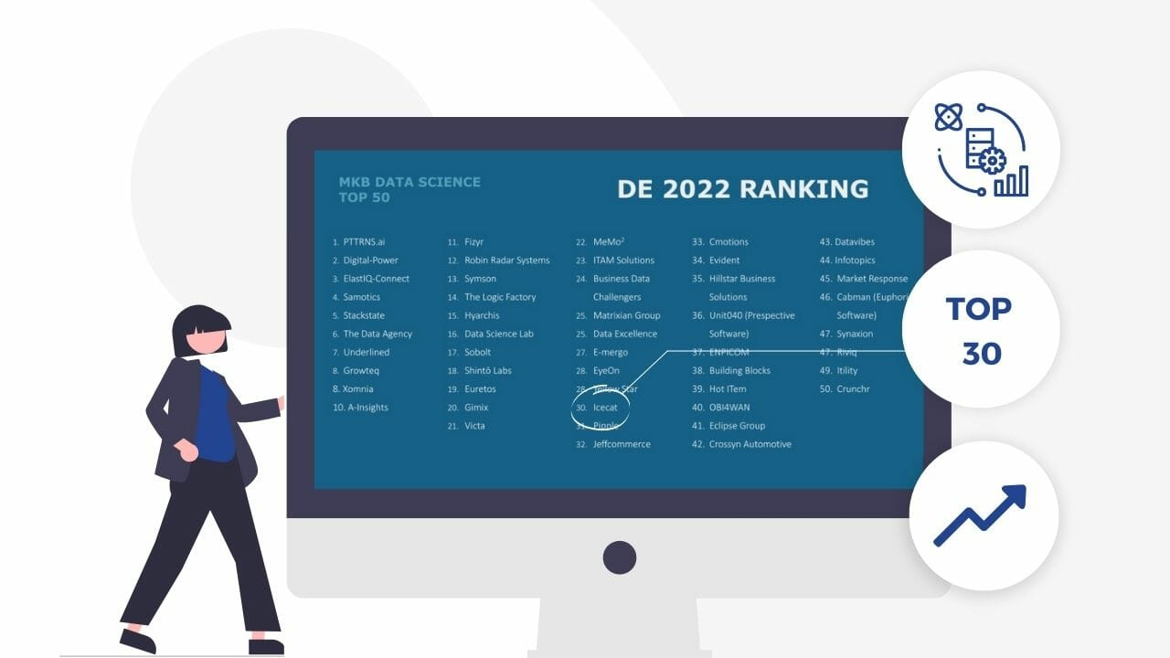
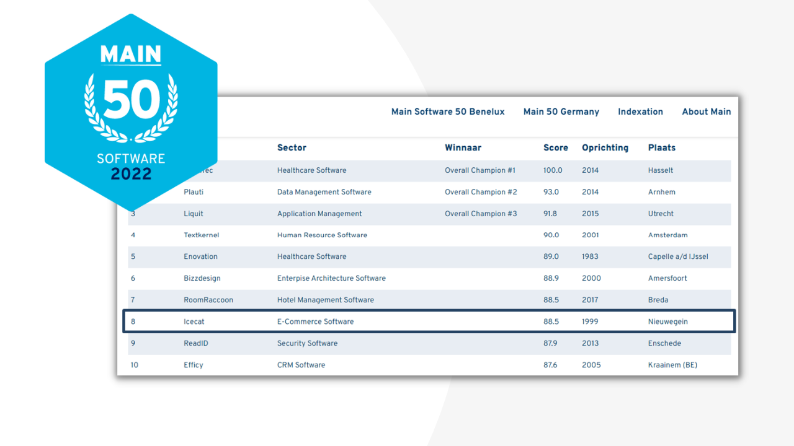
Icecat receives NPEX Award 2022 | Most Traded Stock - YouTube
Icecat Investor Update July 21, 2023

Slide 2
Important Information
This information is not for residents of the USA, Canada, Australia and Japan
This information gives only a limited, historic overview about the performance of Icecat. Investment decisions should also be based on all other information available including, but not exclusively, the prospectus, and sections relating to risks.
Investing in (DRs of) shares is not without risk. An investor can lose his/her investment

Slide 3
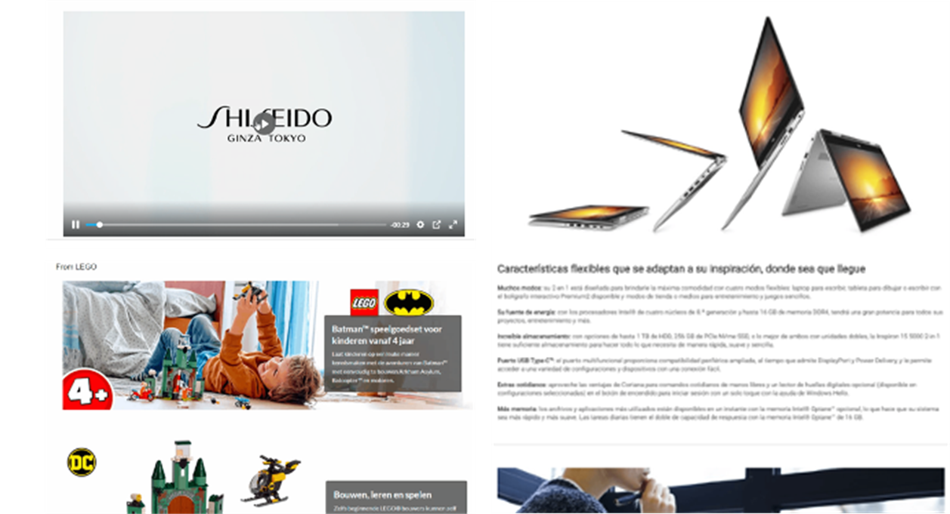
What is Icecat: Helping Consumers Real-Time with Buyer Orientation
Brands Love It:
Enhanced Product Stories
Multimedia
LIVE inserts in retailer sites
Analytics
Product reviews
Recommendations
Cross-sell/Up-sell
LEGO Star Wars Yoda 75255 (intertoys.nl)

Slide 4
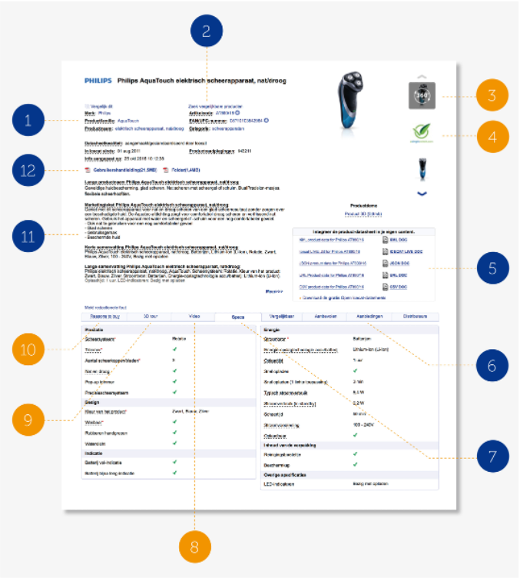
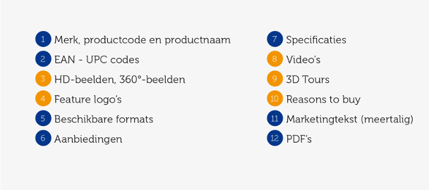
What is Icecat? Multimedia Product Data-Sheets for E-commerce

Slide 5
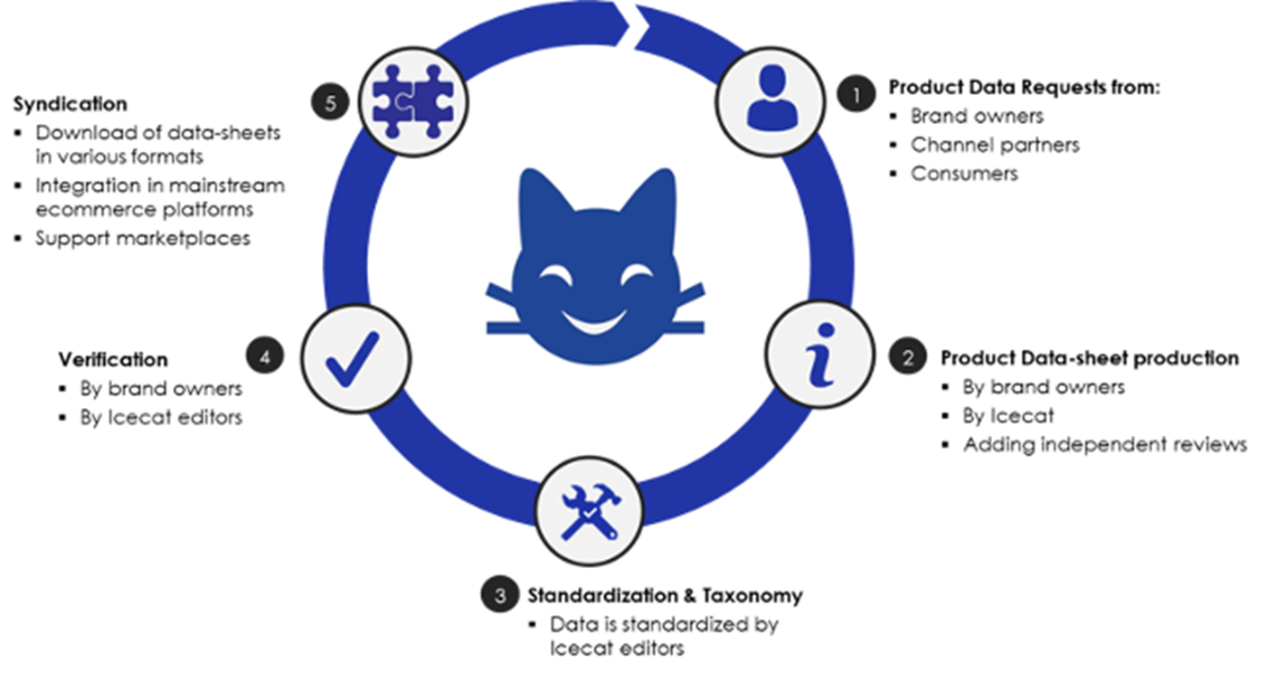
What is Icecat: Global Product Information Management & Syndication

Slide 6
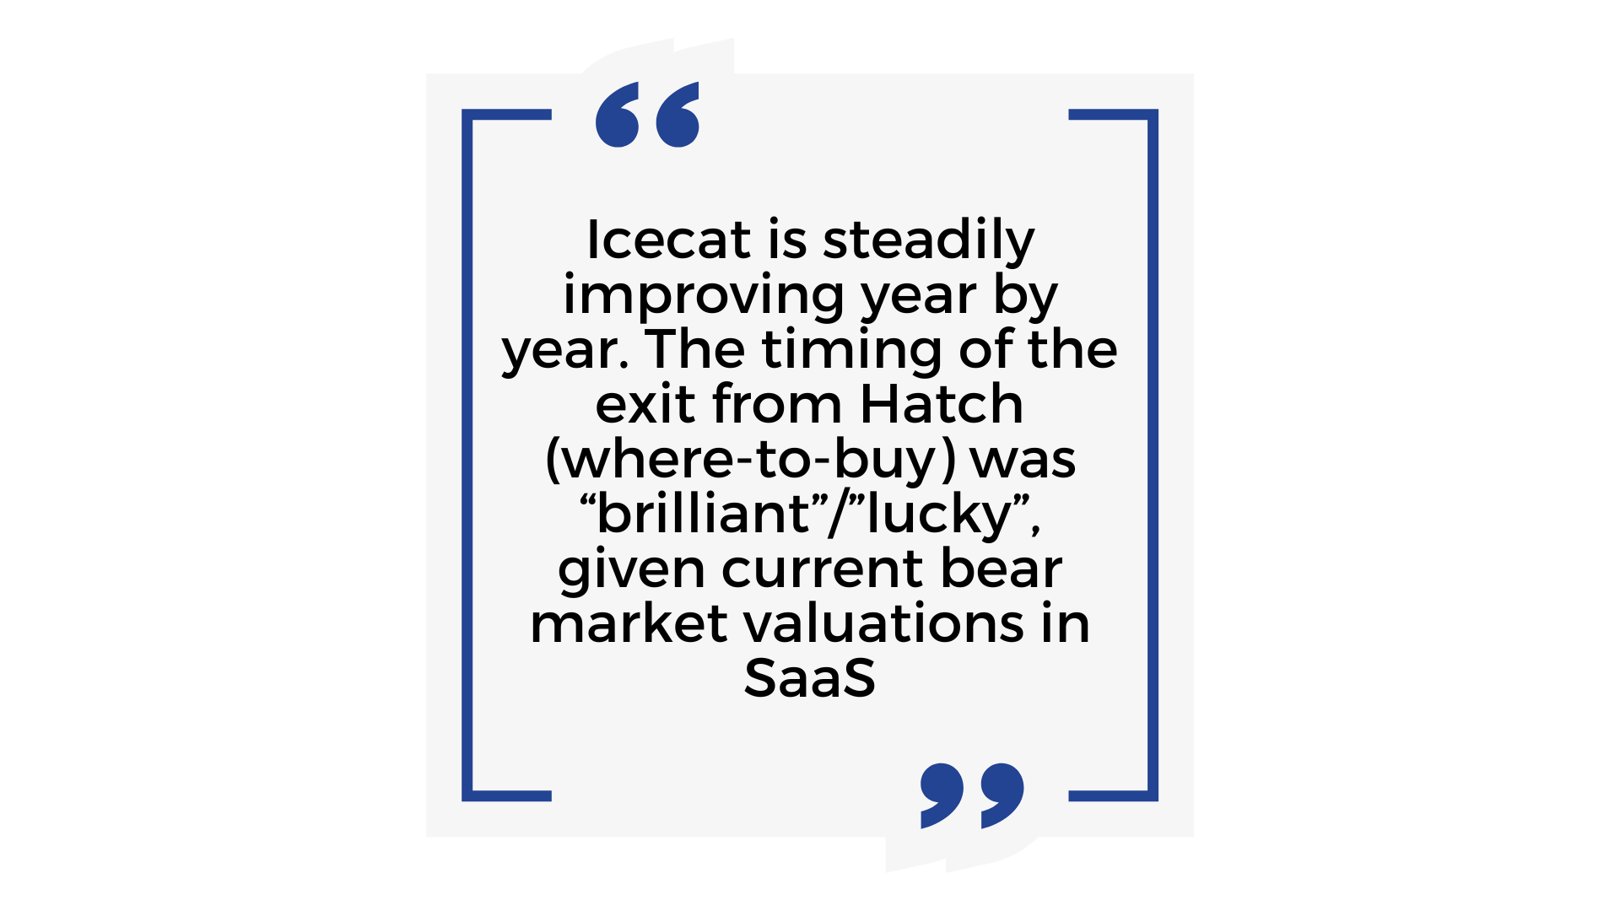
Business Summary
Profitable Fast-Growth Strategy
Revenues 2022: €12M (+15%)
H1-23: €6.6M +2%, but order intake: +19% (non-IFRS)
All growth is organic
Earnings EBIT 2022: €2.45M (2021: €2.17M)
H1-23: € 1.56M (H1-22 € 1.50M)
Icecat Capital:
’22: €3.1M investment in VirtuaGym, fitness club SaaS
‘23: €0.6M investment in NPEX, 10% share
Team size: stable as hiring picks up
Expanding Turkish office
Created US team
Noteworthy client deals:
Amazon expansion MX
ToysRus UK, OTTO.de, Kaufland.de, ..
LEGO, Canon, Whirlpool, Nintendo, Hasbro
Note:
2022 figures are audited, H1-2023 is unaudited
Ongoing purchasing DRs of shares via NPEX for Employees
DR price above intro price (ex-dividend)
No dividend decision (yet) given investment opportunities

Slide 7
The Wonderful Impact of AI
We formed an “editorial” ChatGPT team for:
Large scale Excel transformations
Generating product descriptions
Translations
Quality Assurance assistance
Taxonomy mappings and transformations
Our dev teams apply AI
For debugging, testing, code generation
Specifications and documentation
For automated image classification
Research into training frameworks
Our Services change
Better Chatbots for better supporting clients
AI-assisted blog posts
Open Icecat AI-bot as a new client-API
Our Market changes
Our most sophisticated clients already use Icecat data sets for training their machine learning apps
We see AI-first companies as a key new market
Our open content, all languages approach position us as the global adding product data source
We stay away from
Personal data (GDPR)
Unlicensed 3rd party copyrighted materials

Slide 8
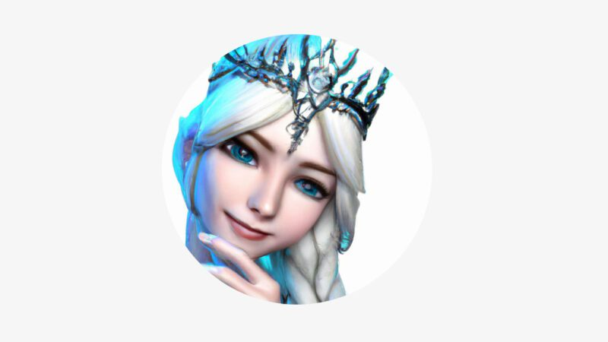
Changes in The Board
New appointments:
Guillaume Stritmatter CTO (Jan ‘22)
René Rozendal CBDO (Jan ‘22)
Sasha Velychko CIO (May ’23)
“Elsa Frozenbrain” CAO (May ’23) https://www.google.com/search?q=elsa+frozenbrain+icecat
The other directors and ordinary board members remain in post

Slide 9
Impact of the War in Ukraine
Contingency plans are executed
After evacuation most staff returned home; some abroad
UAid.charity is highly appreciated by UA colleagues
Istanbul office is more than a fallback now
Systems run all safe in the EU or US
After a few weeks of turbulence all UA dev and editorial teams are back to speed
We received many applications as a solid employer in UA
We paused our (limited) commercial business in Russia
The direct impact of the war on our business is neglectable

Slide 10
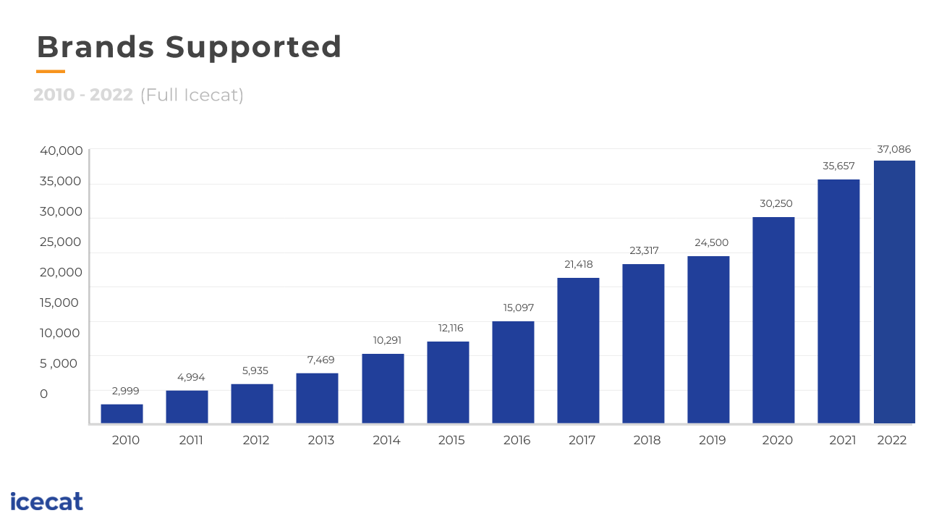
Non-financial KPIs: expansion in covered brands to 37K in 2022

Slide 11
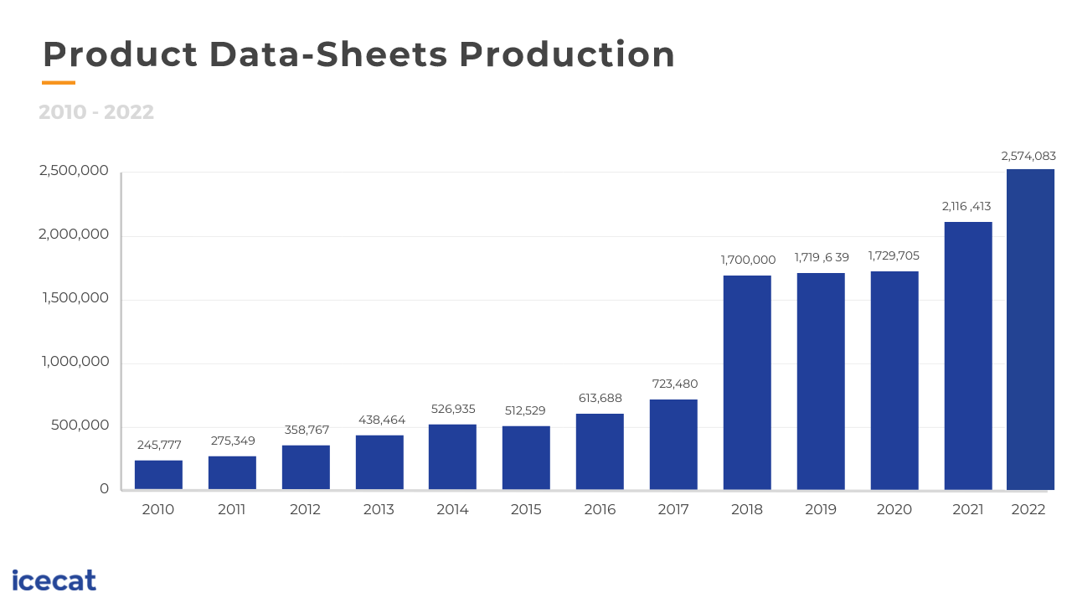
Non-financial KPIs: +20% production hike to 2.6M
data-sheets in 2022

Slide 12
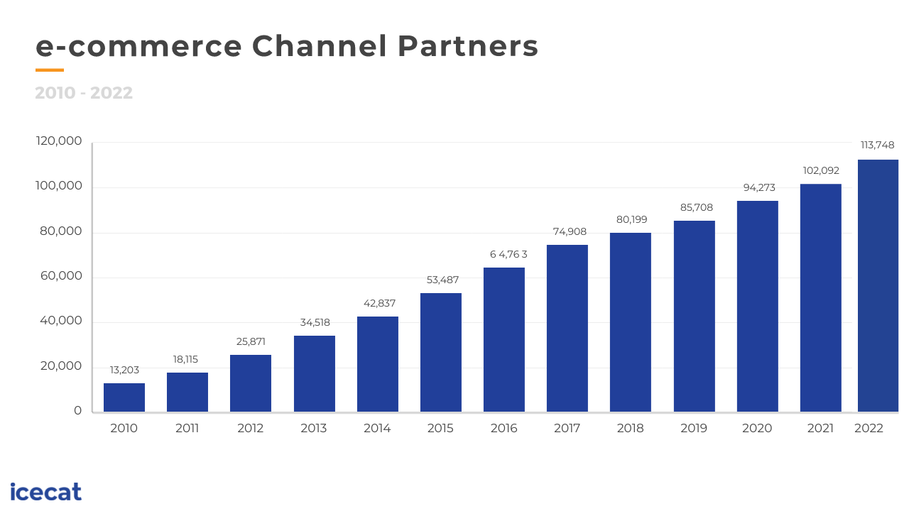
Non-financial KPIs: 19 Bio (+28%) downloads 2022 by 114K (+11% ) users

Slide 13
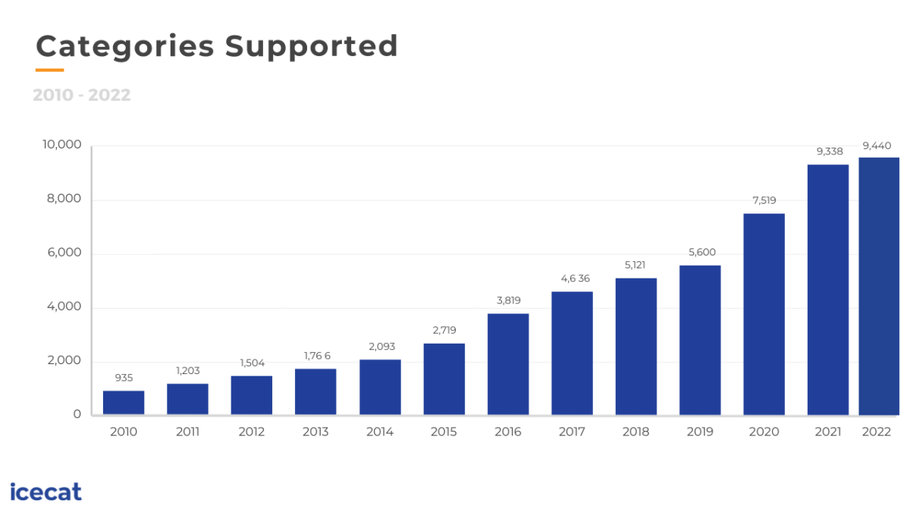
Non-financial KPIs: Categories Supported

Slide 14
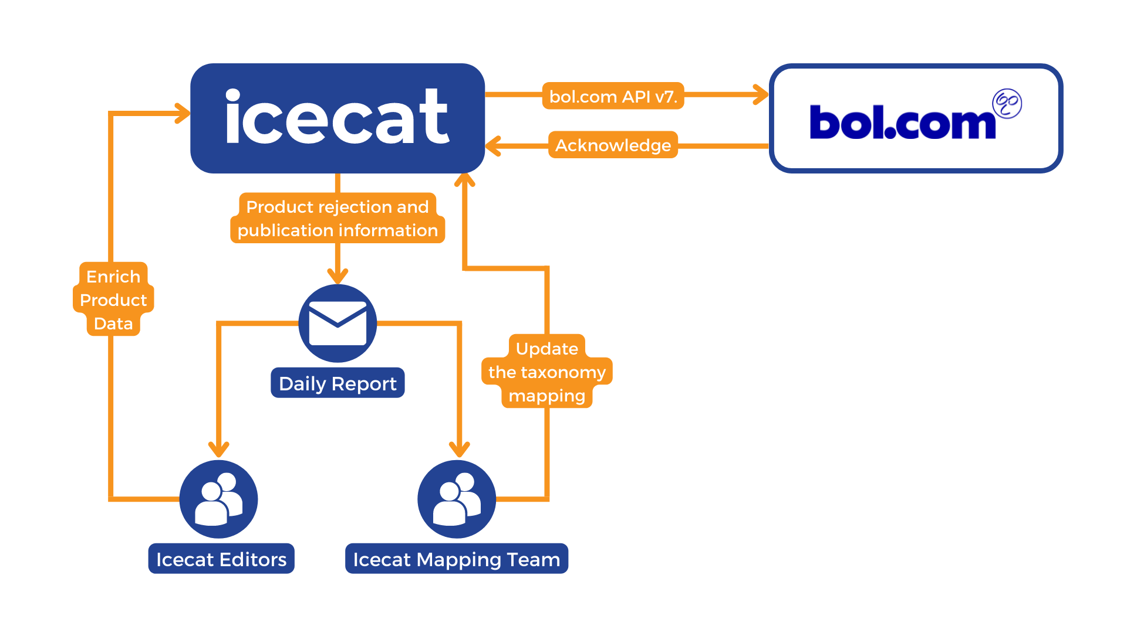
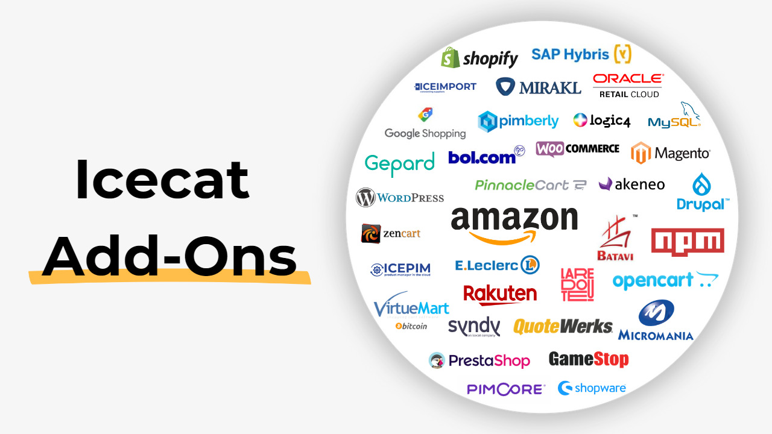
What is new? Amazon multimedia (API), Mirakl connections operational
Iceclog: Migrating Brands to the new Bol.com API Iceclog: New Icecat Amazon Listings API Connection for Brands & Sellers

Slide 15
Key Innovations
“Hexagon” platform for integrations marketplaces like Mirakl, BOL. Phased out legacy video games platform.
AI-generated translations, summaries, specs
Open source Pimcore and Magento add-ons
Large scale production of Branded Product Stories 2.0 (mini sites Apple, DELL, HP, LEGO, etc.)
User Generated Content
Brand Rank Page: improvements dashboard to benchmark brand performance
Expanding interfaces to Google Shopping, Amazon, Facebook, Alibaba/Ali Express

Slide 16
Changes in Competition:
Rationalization Phase; Classic Global (US) Competitors Faltering
Salsify (US): no further acquisitions
1WorldSync (US)
rationalizes Content Solutions
buys Atrify Germany from GS1
Syndigo (US): no further acquisitions
GfK announces merger with Nielsen IQ
Advent (Nielsen IQ) has majority in combination
Rationalization of the analytics industry
Logically brandbank (NielsenIQ) is combined with Etilize
Productsup swoops up World Of Content (NL)
Icecat: talks
Minority investments: Virtuagym (‘22), NPEX (‘23), ..

Slide 17
Risks
Consolidation and shake-out in E-commerce market
Global Market-Places could become too dominant
War in Ukraine might (again) disrupt local work force
Supply chain disruptions affect e-commerce
Investments in ventures might not continue to pay off
Stagflation scenarios
Depressed financial markets leading to lower valuations
Increased competition in our PIMS space
Modified legal frameworks regarding content use
Other risks as identified in the prospectus and other communications

Slide 18
Questions?
Invest in Icecat, global publisher and syndicator of product content

Slide 19
Thank You!

